Slide 1
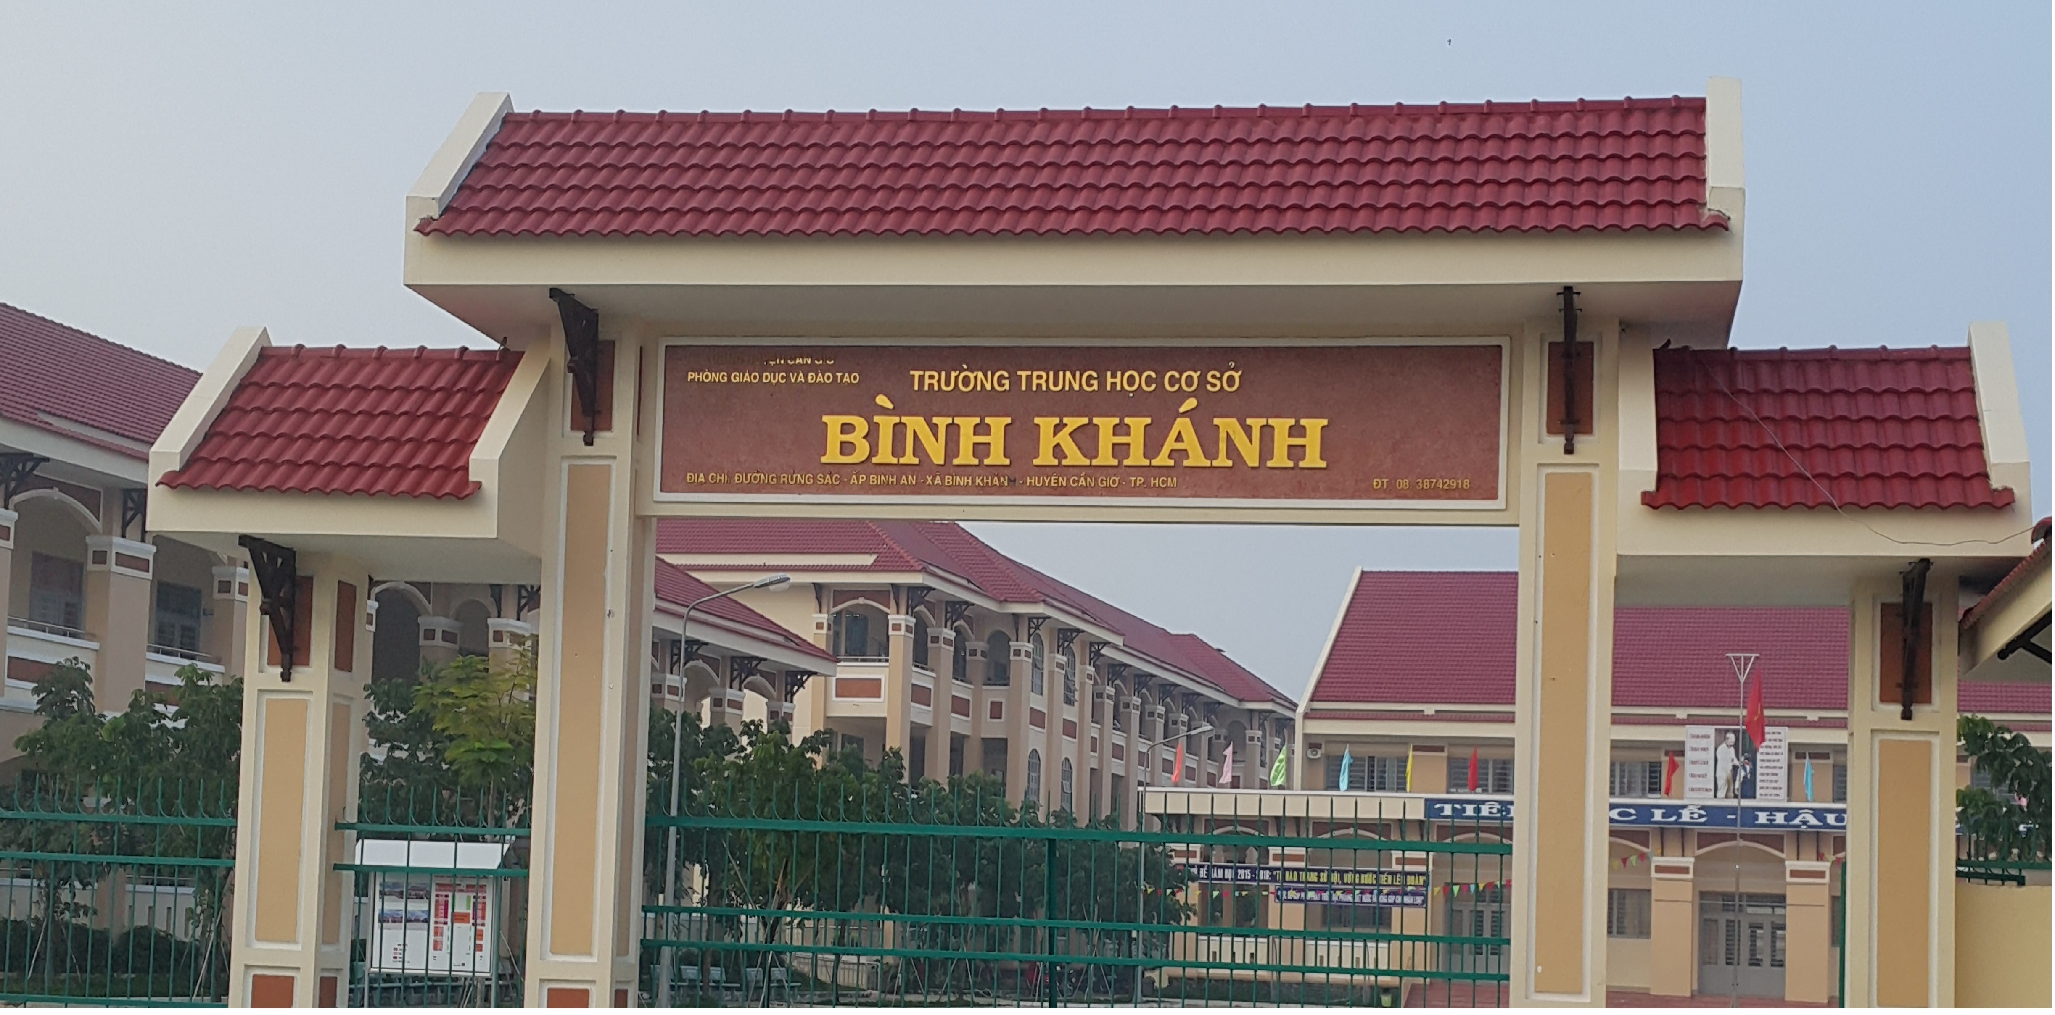
ENGLISH 9
BINH KHANH SECONDARY SCHOOL

Slide 2

WELCOME TO MY CLASS
Good morning Everybody

Slide 3


Unit 7
Saving Energy
WRITE

Slide 4

I. Vocabulary:
- sum up (v):
tóm tắt, tóm lại
- attention (n):
sự chú ý
- detail (n):
chi tiết
- draft (v):
phác thảo, nháp
- solid (a):
rắn (trạng thái)

Slide 5
I. Vocabulary:
MATCHING
- sum up (v):
chi tiết
- attention (n):
rắn (trạng thái)
- detail (n):
phác thảo, nháp
- draft (v):
tóm tắt, tóm lại
- solid (a):
sự chú ý

Slide 6
II. Parts of a speech:
1. Matching:
Match each part of a speech in column A to a suitable function in column B.
Parts of a speech (A) | Functions (B)
1. Introduction
A. summing up what you have said.
B. getting people’s attention and telling them what you are going to talk about.
2. Body
3. Conclusion
C. giving details in easy-to-understand language.

Slide 7
II. Parts of a speech:
1. Matching:
There are 3 parts:
Introduction: getting people’s attention
and telling them what you
are going to talk about.
2. Body: giving details in easy-to-
understand language.
3. Conclusion: summing up what you
have said.

Slide 8
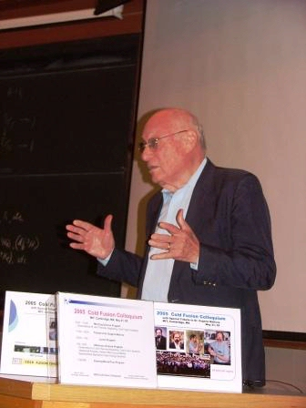
Write a speech:
Professor Roberts

Slide 9
2. Ordering:
Put the following sections in the correct place to complete a speech.
1. If you follow these simple rules, not only will you save money, but also the environment will be cleaner.
2. Most of us use too much gas. You can reduce this amount by:
- traveling by bicycle or public transport.
- having a mechanic check your motorcycle regularly.
3. Good evening, ladies and gentlemen. I’m Professor Roberts and tonight I’m going to tell you how to save money.

Slide 10
3. Good evening, ladies and gentlemen. I’m Professor Roberts and tonight I’m going to tell you how to save money.
evening
ladies and gentlemen
Professor Roberts
tonight
use too much gas
2. Most of us use too much gas. You can reduce this amount by:
- Traveling by bicycle or public transport
- Traveling by bicycle or public transport
- Having a mechanic check your motorcycle regularly
- Having a mechanic check your motorcycle regularly
1. If you follow these simple rules, not only will you save money, but also the environment will be cleaner.
save money

Slide 11


- Collect plastic bags
Reducing garbage
Not keep solid waste with food waste.
Put different kinds of waste in different places.
Reusing paper
Have a separate wastebasket for wastepaper
Keep sheets with single printed page for drafting
Saving energy in the kitchen
- Turn off the lights.
- Prepare food carefully before turning on the stove
- Keep refrigerator door closed

Slide 12
Introduction: greeting/ introducing name/ what to talk about.
2. Body: call out the problem/ how to solve it (details).
3. Conclusion: sum up and emphasize the effect of the solution.

Slide 13
III. Write:
Choose one of the following topics and prepare a speech for your classmates. The ideas in the callouts may help you.

Slide 14
(Possible answer) Reducing garbage:
Good morning, everybody. I’m (Lien) and today, I am going to tell you how to reduce garbage.
Most of us produce too much garbage everyday. You can reduce this amount by:
- collecting plastic bags.
- not keeping solid waste with food waste.
- putting different kinds of waste in different places.
If you follow these simple rules, not only will you reduce garbage, but also keep the environment cleaner.

Slide 15
(Possible answer) Reusing paper:
Good afternoon. I’m (Ba) and today I am going to tell you how to reuse paper.
Most of us produce too much paper. You can reuse paper by:
- having a separate wastebasket for waste paper.
keeping sheets with single printed page for drafting
If you follow these simple rules, not only will you reuse paper, but also you will save money.

Slide 16
(Possible answer) Saving energy in the kitchen:
Good evening, ladies and gentlemen. I’m (Ba) and tonight, I am going to tell you how to save energy in the kitchen.
Most of us waste too much energy in the kitchen. You can save this amount by:
- turning off the lights.
- preparing food carefully before turning on the stove.
- keeping refrigerator door closed.
If you follow these simple rules, not only will you save energy, save money but also your appliances can work effectively.

Slide 17
VI. Homework:
* Rewrite your speech at home.
* Prepare : language focus

Slide 18


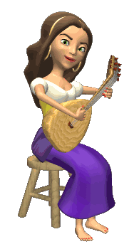

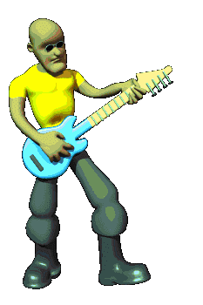
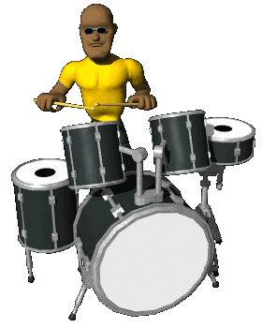

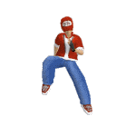



THANK YOU
FOR YOUR ATTENTION !
Goodbye !
Celinne Dion – And so this is Xmax

Slide 19
Hai Duong, Monday, Fabruary, 16th, 2009
ENGLISH 9
Period 46
Unit 7: Saving energy
Lesson 5 : Write:
Write a speech
10
* Notice: “not only….but also ” in the Conditional sentence Type 1
If you follow these simple rules, you will not only save money
but also the environment will be cleaner.
If you follow these simple rules, not only will you save money
but also the environment will be cleaner.
Back

